Slide 1

Introduction to Software Engineering (ISE102) Tutorial Week 3

Slide 2
Object-Oriented Programming (OOP) Basics
OOP is like building with LEGO:
Each LEGO piece = Object (it has shape, colour, purpose)
LEGO instructions = Class (blueprint to create objects)

Slide 3
Object-Oriented Programming (OOP) Basics
Key OOP ideas:
Class – blueprint (e.g., “Car” design)
Object – actual item made from the blueprint (e.g., a Toyota Corolla in Sydney)
Attributes – properties (e.g., colour, model)
Methods – actions (e.g., start engine, honk)

Slide 4
Object-Oriented Programming (OOP) Basics
Australian Example:
Class: Kangaroo
Objects: Red Kangaroo, Eastern Grey Kangaroo in NSW
Attributes: tailLength, weight
Methods: hop(), eatGrass()

Slide 5
Object-Oriented Programming (OOP) Basics
OOP Concept | Real-world Analogy | Australian Example
Class | Building design | "Opal Tower" plan in Sydney
Object | Actual building | Completed Opal Tower
Attributes | Room size, colour | Apartment floor plan
Methods | Actions | Lift moves, lights turn on

Slide 6
Object-Oriented Programming (OOP) Basics
Research Discussion Question: Why do modern apps in Australia (e.g., MyGov, Service NSW) use OOP rather than procedural programming?
Because OOP allows reusable code, easy maintenance, and modelling of real-world services like forms, accounts, and processes.

Slide 7
Object-Oriented Programming (OOP) Basics
Research Discussion Question: Why does Commonwealth Bank’s NetBank use OOP principles instead of procedural programming for its online banking platform?
OOP lets developers create reusable classes like Account, Transaction, and Customer, so features such as viewing statements or transferring money can be reused across mobile and web apps. It also makes it easier to maintain security, adapt to new regulations (like ASIC compliance), and roll out new services such as PayID without rewriting large parts of the system.

Slide 8
Object-Oriented Programming (OOP) Basics
Australian Real-World Analogy Think of NetBank as a shopping centre:
Classes = store blueprints (e.g., Woolworths, JB Hi-Fi)
Objects = actual store branches in the centre
Updating one blueprint updates all branches — just like updating one class in OOP updates all relevant objects in the system.

Slide 9
Hands-On Activity 1 (CBA_BankAccount_Deposit)
Write a class BankAccount in Java or Python with:
Two attributes: account_holder and balance
One method: deposit(amount) that increases the balance and prints the new balance

Slide 10
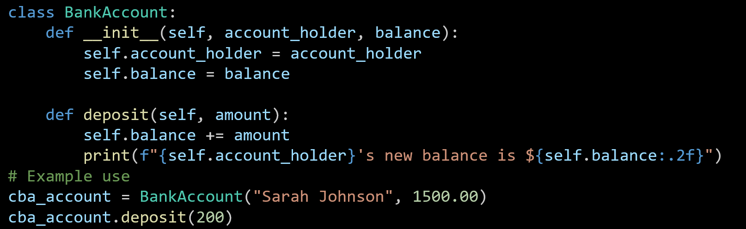
Hands-On Activity 1 (CBA_BankAccount_Deposit in Python)
The BankAccount class is created with two attributes: the account holder’s name and their balance.
The deposit method adds money to the balance and shows the updated amount.
An example account for Sarah Johnson is created, and $200 is deposited to update her balance.

Slide 11
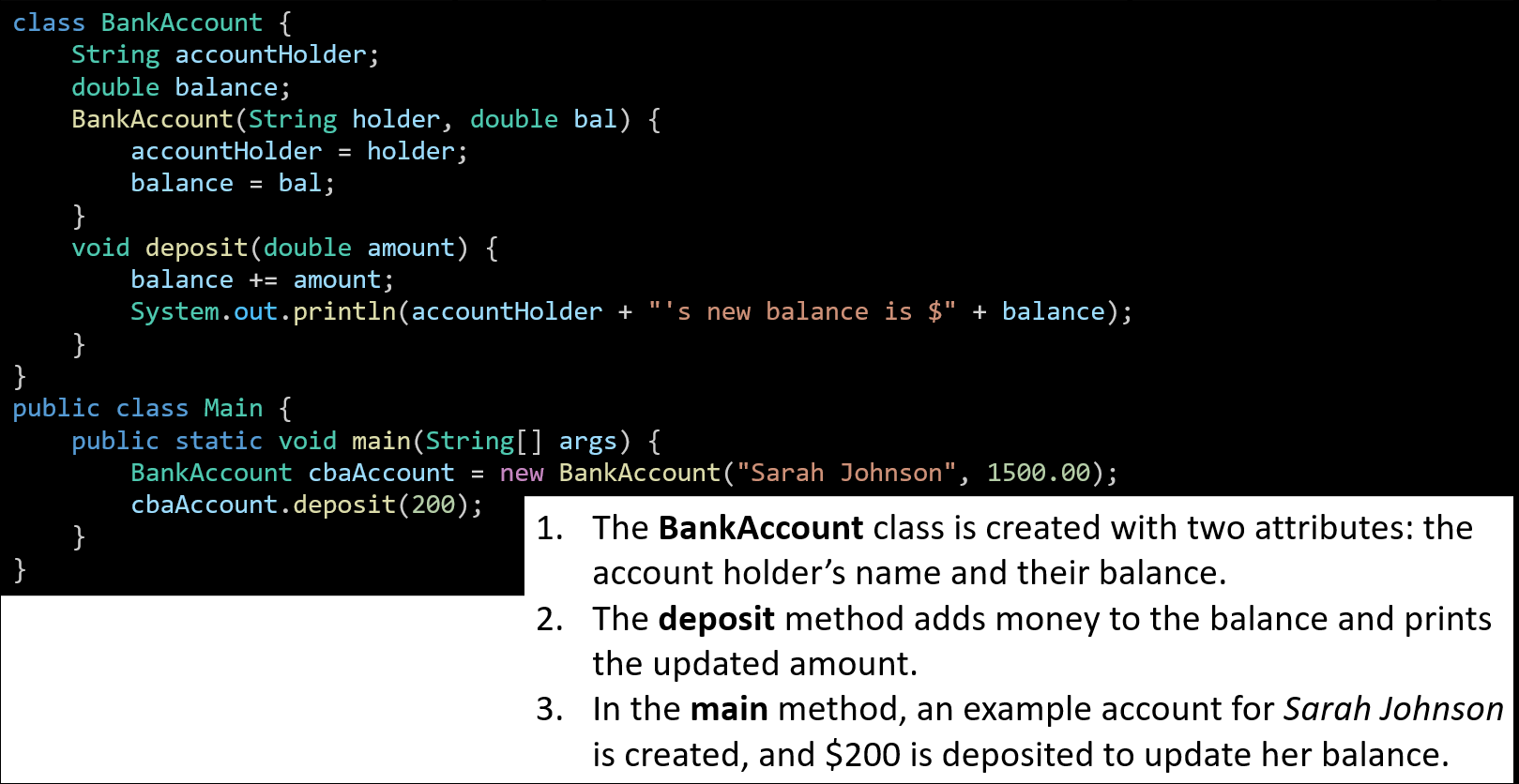
Hands-On Activity 1 (CBA_BankAccount_Deposit in Java)
The BankAccount class is created with two attributes: the account holder’s name and their balance.
The deposit method adds money to the balance and prints the updated amount.
In the main method, an example account for Sarah Johnson is created, and $200 is deposited to update her balance.

Slide 12
Hands-On Activity 2 (OOP Example – Train Class)
Build a class Train that can show the train number and destination (e.g., Sydney → Newcastle). Use Python or Java.

Slide 13
Hands-On Activity 3 (Create Your Favourite Aussie Sport Class)
Create a class for a favourite Aussie sport (e.g., CricketPlayer) with attributes and actions.

Slide 14
Hands-On Activity 4 (Create Multiple Objects and Call Their Methods)
Write code to create two different objects from the same class and call their methods.

Slide 15
Data Types, Variables, and Operators
Variables are like containers that store information.
Python: Flexible – you can put anything inside.
Java: Strict – each container has a label for the type it can hold.

Slide 16
Data Types, Variables, and Operators
These types are explicitly defined in Java, but Python handles them differently:
Java: We must declare the type (int age = 25;) – it’s strictly typed.
Python: We don’t declare the type (age = 25) – it’s dynamically typed, but those kinds of values still exist.
Common types:
int – whole numbers
float / double – decimals
boolean – true/false
char – one letter
String – text

Slide 17
Data Types, Variables, and Operators
So:
In Java, int, double, boolean, char, and String are actual type keywords (except String, which is a class).
In Python, the variable type is inferred automatically, but it still stores integers, floats, booleans, strings, etc. (char isn’t a separate type; it’s just a string of length 1).
Common types:
int – whole numbers
float / double – decimals
boolean – true/false
char – one letter
String – text

Slide 18
Data Types, Variables, and Operators
Australian Example:
Temperature in Sydney: float
Number of trams in Melbourne: int
Is it a public holiday in NSW? boolean
Type | Python Example | Java Example
int | age = 25 | int age = 25;
float/double | price = 4.5 | double price = 4.5;
boolean | sunny = True | boolean sunny = true;

Slide 19
Data Types, Variables, and Operators
Research Discussion Question: Why is it important to choose the correct data type for Australian weather data?
Correct types ensure accurate storage and calculations, e.g., temperature needs decimals for precision

Slide 20
Hands-On Activity 5: Data Types, Variables, and Operators
Declare and print three variables for your suburb’s name, current temperature, and if it’s raining. (in python or java)

Slide 21
Hands-On Activity 5: Data Types, Variables, and Operators
Python
suburb = "Castle Hill"
temperature = 22.5
is_raining = False
print(suburb, temperature, is_raining)

Slide 22
Hands-On Activity 5: Data Types, Variables, and Operators
Java
suburb = "Castle Hill"
temperature = 22.5
is_raining = False
print(suburb, temperature, is_raining)
In Java, all code that runs must be inside a method, usually the main method, and inside a class.

Slide 23
Hands-On Activity 5: Data Types, Variables, and Operators
Java
suburb = "Castle Hill"
temperature = 22.5
is_raining = False
print(suburb, temperature, is_raining)
In Java, all code that runs must be inside a method, usually the main method, and inside a class.

Slide 24
Strings & String Formatting
String = text data.
Formatting = inserting variables into text.
Think of it like a fill-in-the-blank postcard.
Australian Example:
"Welcome to {}!" → "Welcome to Sydney!"

Slide 25
Strings & String Formatting
Python Example:
city = "Sydney"
print(f"Welcome to {city}!")

Slide 26
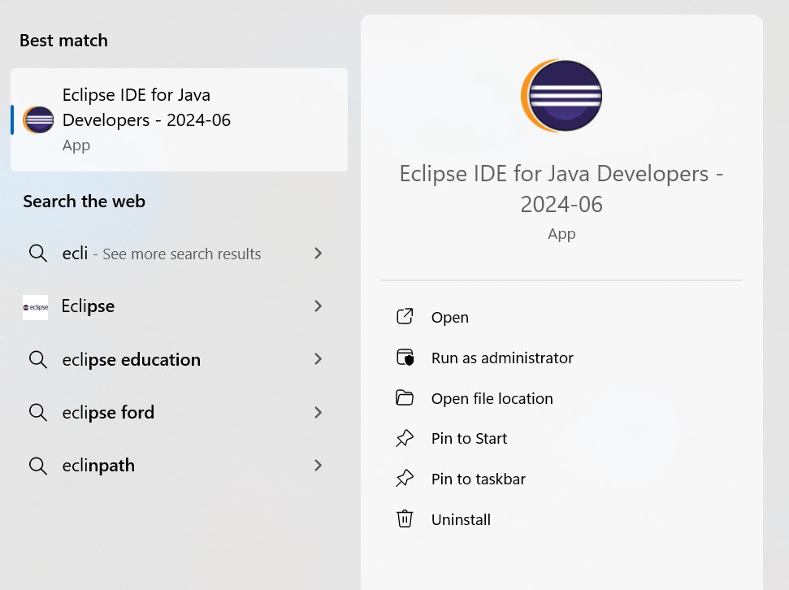
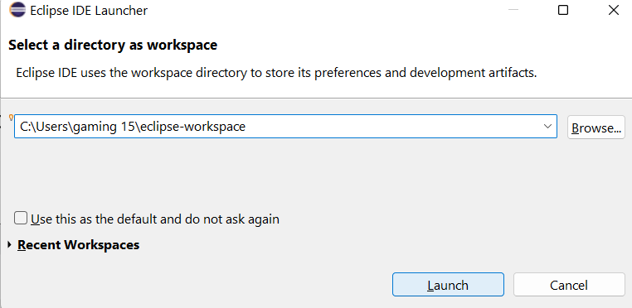
Strings & String Formatting
Java Example:

Slide 27
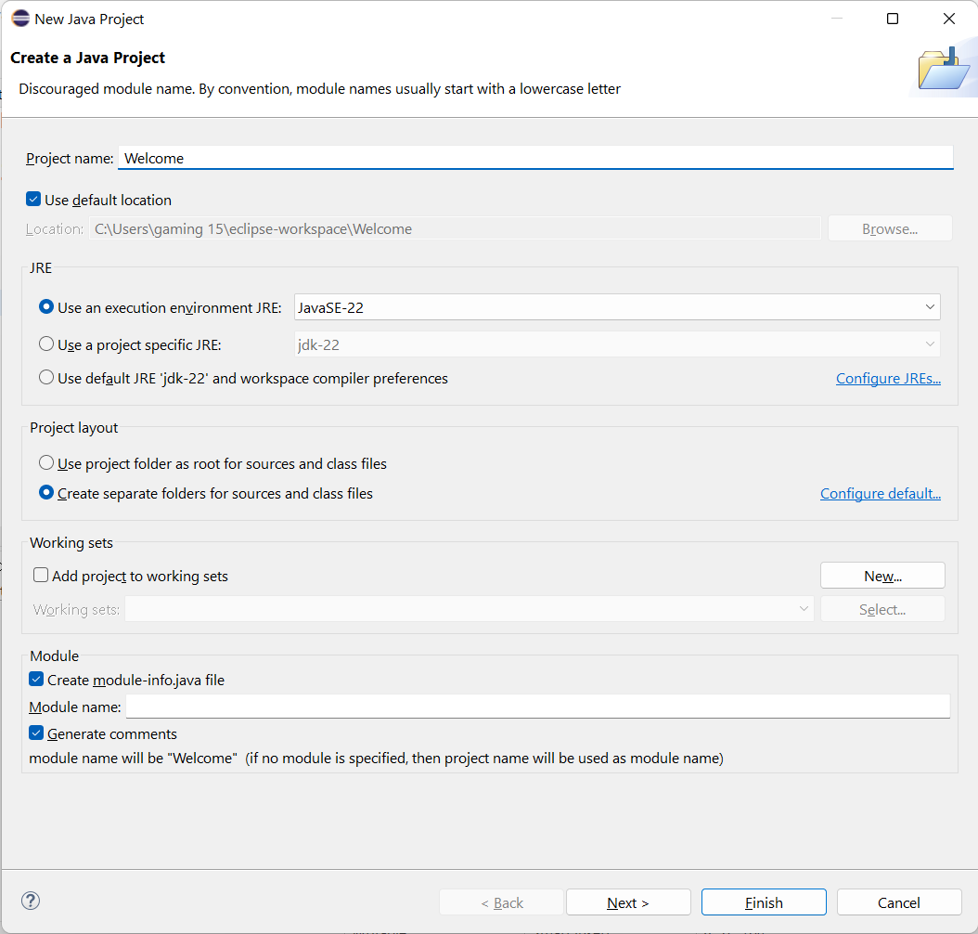
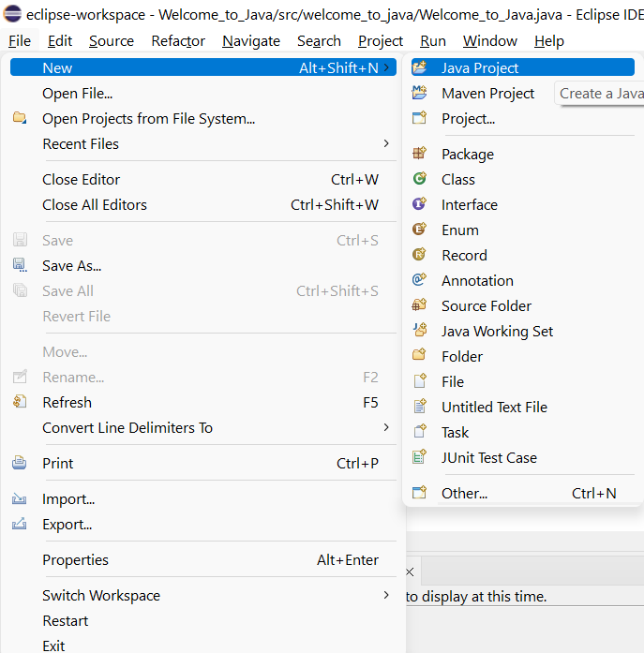
Strings & String Formatting
New Java Project

Slide 28
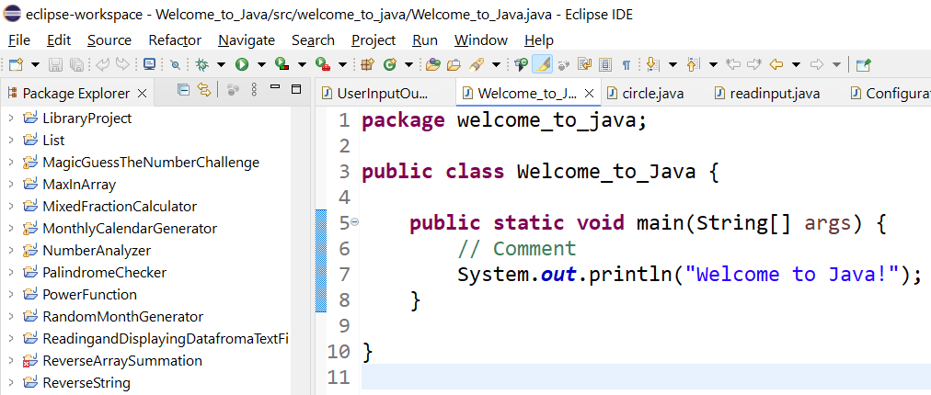
Java Code
package welcome_to_java; – Groups this class into a package called welcome_to_java.
public class Welcome_to_Java { ... } – Defines a public class named Welcome_to_Java.
public static void main(String[] args) – The entry point where the program starts running.

Slide 29
Java Code
// Comment – A note for humans, ignored by the computer.
System.out.println("Welcome to Java!"); – Prints the message Welcome to Java! on the screen.

Slide 30
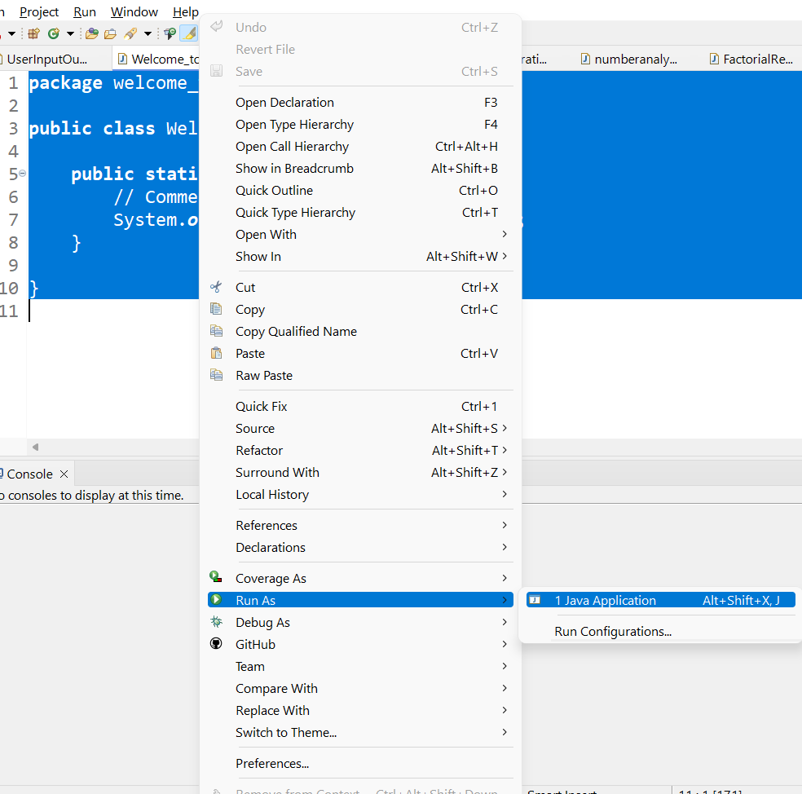
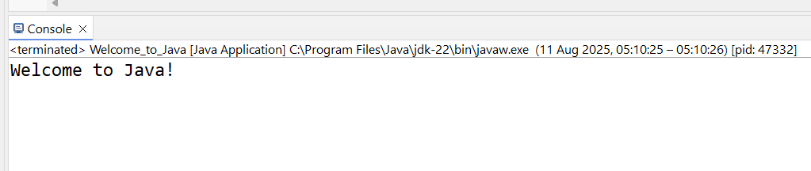
Strings & String Formatting
Run as Java Application

Slide 31

Happy Learning and Bright Futures Ahead! Dr. Farshid Keivanian Stay Connected: linkedin.com/in/farshid-keivanian github.com/FarshidKeivanian
Education is the most powerful weapon you can use to change the world. — Nelson Mandela

